Slide 1
Annual Internal Quality Audit - Closing Meeting
Lead Auditor : Simy Li
Auditor : Shannon Tsui, Brian Wong, Ringo Yu, Kelvin Tsoi
DAP Lead Auditor : Suki Kwong
Auditor Trainees : Else Man, Cammy Hung, Cathy Fan
Date : Feb 21-22, 2017

Slide 2
Observation 1 – from Brian Wong
Requirement : SOP 00-OP-J0851 (Page 3)
Evaluator is responsible for identifying the request as Non-Certification, providing request details and forwarding customer communications.
Non-compliance : No L2 evaluator to identify the request that can be considered as non-certification project.
Evidence : Project #4787819366
Responsible Person : Else Man (CAR# 173917124)

Slide 3
Observation 2 – from Brian Wong
Requirement : ISO 17025 Clause 5.5.2 Equipment
Equipment …. Shall be capable of achieving the accuracy required and shall comply with specifications relevant to the tests …… equipment shall be … checked to establish that it meets the laboratory’s specification requirements ….
Non-compliance : Power source PS020 – 120 V, 60 Hz; 240 V, 60 Hz had not been conducted power measurement
Evidence : Power source PS020 – 120 V, 60 Hz; 240 V, 60 Hz
Responsible Person : Ryan Leung (CAR# 173917127)

Slide 4
Observation 3 – from Brian Wong
Requirement : 00-LO-S0409 Clause 6.1.5
When critical consumables reach their expiration date, they shall be promptly removed from service, and be dispositioned.
Non-conformance : The critical consumable material, Endecots Wire Gauze (CC2386), exceeded 5 years’ shelf life from first acceptance date 2011-10-04 till it was found on 2017-02-22.
Evidence : CC2386 - Endecots Wire Gauze
Responsible Person : Ryan Leung (CAR# 173917123)

Slide 5
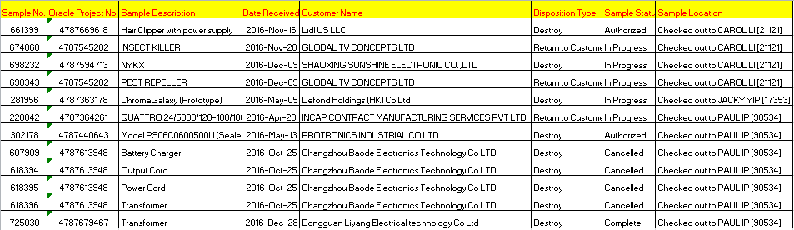
Observation 4 – from Ringo Yu
Requirement : 11-LO-W0404, Local Sample Handling
Clause 9.11.1 requires once the supervisor confirm the sample holder will leave the company, he / she has to provide a sample checked out record from the system for the sample holder to collect the samples back, and return the samples to sample cage before he/she leave the company.
Non-compliance :
Staff left or transferred to other department still held the samples in the sample record.
Evidence : Left / Transferred staff (i.e.: Carol Li, Jacky Yip, Paul Ip) still kept the sample.
Responsible Person : Else Man (CAR# 173917125)

Slide 6
Observation 5 – from Ringo Yu
Requirement : ISO 17025 Clause 4.3.2.2 c) and 11-LO-W0404, Local Sample Handling Sec. 5.0, Applicable Document
Invalid or obsolete documents are promptly removed from all points of issue or use …….
Non-compliance :
11-LO-F0855 (V1.0) is used whereas the latest version in DCS is V5.0
Evidence : Outdated version 11-LO-F0855 (V1.0) is in use
Responsible Person : Else Man (CAR# 173917126)

Slide 7
Quick Fix 1 – from Ringo Yu
Requirement : 00-OP-P0400, Sample Management Policy
Sec 7.3.2 requires the unique sample ID number for samples is to be maintained for the entire life of a sample. If a sample is sub-divided into multiple parts for testing or other purposes, each of the resulting parts shall be provided with a unique ID number. In such cases, the sample management system used shall be capable of correlating each resulting sample to its original sample ID number.
Non-compliance : Sample status can’t be identifiable
Evidence : Sample #537545 had been split to #470553 by PH but he/she didn't notify local sample staff. Hence, the sample status is uncertainly / can’t be located (e.g.: Either In-House / Destroyed) is shown
Responsible Person : German Cheung (Fixed – the split sample #470553 has been allocated to NWT-VSIC-CAGE and would be destroyed from the record.)

Slide 8
Quick Fix 2 – from Brian Wong
Issue:
Project audit
CSA standard used in datasheet: CSA No. 9.0-96. CSA standard mentioned in Test record summary: CSA No. 12
Datasheet tested under TDTDP. No record in DAP system
Responsible By : HokYin Matthew Wong (Lighting)
- Fixed (SR# 3547042.956737)

Slide 9
Quick Fix 3 – from Cathy Fan
Issue:
1) Wrong project no. (4787449324) was shown on ECD letter in Project 4787447198.
2) No sample no. and test date recorded on datasheet (Project 4787447198)
3) Test Demonstration: Resistance to Tracking -
Test method required the solution NH4Cl to have a purity of not less than 99.8 %. The label on the container show only with >=99.5 %
Solution:
Typo (confirmed by engineer). All other documents are with correct project no.
Responsible Person : Joseph Lie (Noted by Joseph Lie, no amendment on ECD as already sent out to original ECD to the customer earlier. Not intended to change ECD and re-send it to customer.)
Confirmed by engineer, the same samples were tested immediately after Test
Method A was conducted. SR3547148.956793 was created to clarify in more detail.
Responsible Person : Joseph Lie (Fixed)
3) Provide calibration certificate and proved the solution was calibrated with 100 % purity. Purchased solution from other manufacture with the correct specification.
Responsible Person : Ryan Leung (Fixed – COA showed the result of purity was 100%)

Slide 10
Quick Fix 4 – from Else Man
Issue:
NOA is missed to be uploaded to FLEX DOC
LIS, Model no. is different from Description
Evidence :
Project 4787522115.1.1
Solution:
NOA was sent on Dec 29, 2016, it was uploaded to FLEX DOC on Feb 22, 2017
LIS was revised with correct model no. on Feb 22, 2017
Responsible Person : Leung ChiWah (CTECH) - Fixed

Slide 11
Quick Fix 5 - from Else Man
Issue:
Quote was missed to be uploaded to FLEX DOC
Evidence :
Project 4787596682
Solution:
Quote sent on Aug 28, 2016, it was uploaded to FLEX DOC on Feb 22, 2017
Responsible Person : Sally Hui (CTECH) - Fixed

Slide 12
Quick Fix 6 - from Else Man
Issue:
Quote was missed to be attached to FLEX DOC when uploaded documents
2) ECD letter was missed to be attached to FLEX DOC when uploaded documents
Datasheet – Mismatched Standard Revised date (UL 60745-1) with Test Record
4) Missing a statement “including construction review and testing “ (00-OP-S0067 – Issue 32.0 Cl. 150.6.5, Item K)
Test Record Summary statement as illustrated below:
“The results of this investigation, including construction review and testing, indicate that the products evaluated comply with the applicable requirements in [(name of standard(s)) or (the standards noted below)] and, therefore, such products are judged eligible to bear UL's Mark as described on the Conclusion Page of this Report."
Evidence :
Project 4787830129
Solution:
Quote sent on Dec 28, 2016, it was uploaded as FLEX DOC on Feb 22, 2017
ECD sent on Jan 20, 2017, it was uploaded as FLEX DOC on Feb 22, 2017
SR to correct Datasheet
SR to correct Test Record Summary
Responsible Person : Ming Tam (Major Appliances) - Fixed (SR#3548668.957245 )

Slide 13
Quick Fix 7 – from Shannon Tsui
Requirement :
Document Number: 00-OP-S0067 – Issue 32.0, Cl. 150.6.5, Item M
Document Number: 00-CE-S0030 - Issue #: 19.0, Cl. 6.4
“Any information and documentation involving UL Mark services are provided on behalf of UL LLC (UL) or any authorized licensee of UL.”
Non-compliance :
The “Reference to UL and UL Licensee” statement was missing
Evidence : Project 4787607363
Responsible Person : Stanley Chan – Fixed (SR# 3548630.957225)

Slide 14
Quick Fix 8 – from Shannon Tsui/Suki Kwong
Requirement :
Document Number: 00-OP-S0067 – Issue 32.0 Cl. 150.6.5, Item K
Test Record Summary statement as illustrated below:
“The results of this investigation, including construction review and testing, indicate that the products evaluated comply with the applicable requirements in [(name of standard(s)) or (the standards noted below)] and, therefore, such products are judged eligible to bear UL's Mark as described on the Conclusion Page of this Report.”
Non-compliance :
“including construction review and testing,” was missing.
Evidence : Project 4787507950, 4787607363, 4787503040
(ZPMV2, QMFZ, QMQS)
Responsible Person : Sally Hui (SR# SR#3552656.957873), Stanley Chan (SR# 3548630.957225), Rio Leung (SR# 3547162.956803) - Fixed
Responsible PDEs have already been noticed the missing statement, they agreed to take lead to revise the Test Record Summary in e-publisher

Slide 15
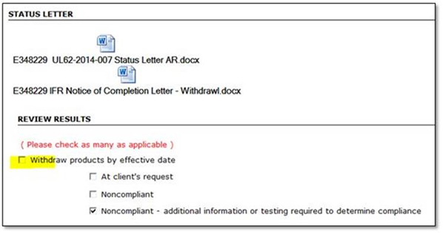
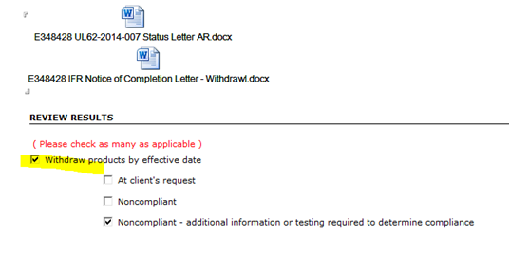
Quick Fix 9 – from Ringo Yu
Issue:
00-OP-S0057, IFR Manual
Sec 6.5 - Withdrawal and/or suspension of requirements having a future effective date >> Handler should select / tick all required field to prevent confusion
Evidence : E348229 & E348428
Responsible Person : Joyce Ng (Fixed – updated the system)

Slide 16
Quick Fix 10 – from Simy Li
Requirement (00-CS-S0012) :
7.0 Any UL employee that receives a customer complaint, unless they are using a Business Unit specific process or are excluded from section 2.0 SCOPE, should submit customer feedback to the Customer Advocacy department either via the Customer Advocacy mailbox (CustomerAdvocacy@ul.com), by contacting one of the Customer Advocates directly, or via the online webform
Issue (Ctech/Customer Advocacy) :
A Customer Multek Engineering complained UL Taiwan lab wrongly took out the 56-day test samples when the lab technician finished the tests on the 10-day test samples with negative result. Such complaint had not been informed Customer Advocacy team.
Solution:
Update the whole complaint to Shelly Liu – Action by Claire (Fixed - resent to Shelly)
Need to inform Customer Advocacy team upon receipt any customer complaint in future – Action by all EMs (as gatekeeper) (Fixed – QM has informed all EMs to do so)
Responsible Person : EM / Claire Ng

Slide 17
Quick Fix 11 – from Suki Kwong
Issue : Initial is used without traceability to the responsible person
Requirement :
SOP 00-LO-S0829 - Commercial And Industrial Business - Testing Related Records
Clause 6.1.3 C
1. Record the person(s) responsible for conducting testing by entering their name(s) or UL Employee ID Number(s). This is not a signature.
2. When initialing is needed, use of the person’s UL Employee ID is acceptable in lieu of the person’s typed initials.
Evidence : Project 4786503040, E159271, report date 2016-07-07, Test Record 1, T1-DS2, P.6 (see next page)
Solution: SR#3547162.956803 (Fixed)
Responsible Person : YickHo Chan

Slide 18
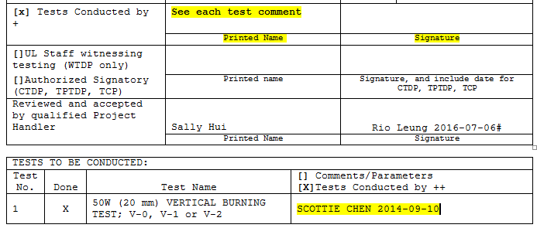
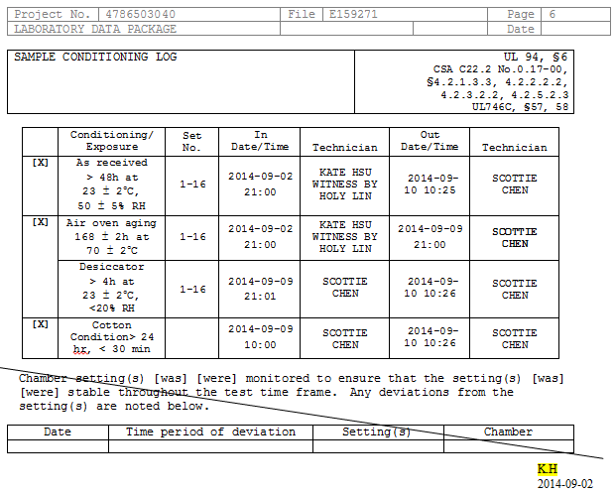
Quick Fix 11 – from Suki Kwong (Con’d)
Fixed

Slide 19
Quick Fix 12 – from Suki Kwong
Issue : Inconsistent Printed Name and Signature
Requirement :
Cover Page of the Datasheet: “Reviewed and accepted by”
Evidence :
Project 4786503040, E159271, report date 2016-07-07,
Test Record 1, T1-DS2, P.1
Printed Name: “Sally” Hui” vs Siguature: “Rio Leung”
Solution: SR#3547162.956803 (Fixed)
Responsible Person : YickHo Chan
19

Slide 20
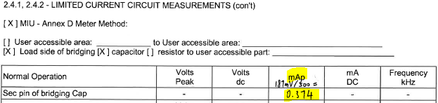
Quick Fix 13 – from Suki Kwong
Issue:
IEC60950-1, Clause 2.4.1. 2.4.2, LIMITED CURRENT CIRCUIT MEASUREMENTS
[X ] Annex D.1. Using the measuring instrument in Annex D.1, Figure D.1, the voltage U2 was measured and the current calculated by dividing the measured voltage U2 by 500.
→ After measured voltage U2 (187mV), it is used for calculation of the current immediately (without marked down the original data)
Requirement:
SOP 00-LO-S0829 - Commercial And Industrial Business - Testing Related Records
6.3.2 Original observations, data and calculations must be recorded at the time they are made and saved as part of the technical records of testing.
(ISO/IEC 17025, Clause 4.13.2.2)
Solution:
Recorded the observation raw data of the voltage U2 (187mV) and the calculation
Responsible Person : Ryan Leung (Fixed – this is a dummy project. No need to correct the DS. Shared this issue to teammates.)

Slide 21
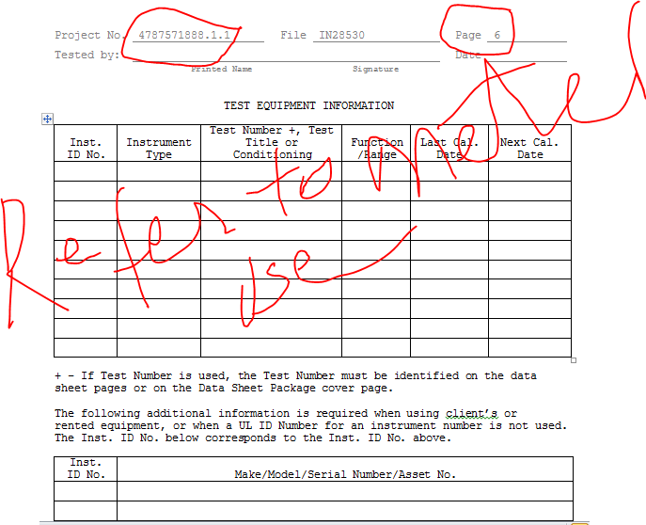
Quick Fix 14 – from Simy Li
Issue :
Datasheet was missed to be filled the Test Equipment Information and check box in the Note field
Project : 4787511728.1.1
DS2
Responsible Person : WingKai Ng / Ivan Choi
SR 3585246.961304 (Fixed)

Slide 22
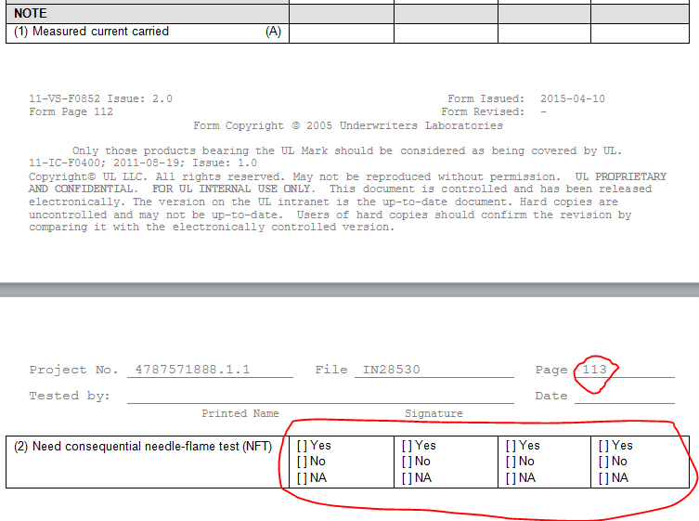
Quick Fix 14 – from Simy Li (Con’d)
Fixed

Slide 23
Recommendation 1 – from Brian Wong
Requirement : ISO 17025 Clause 5.4.7.2 Control of Data
The laboratory shall ensure that procedures are established and implemented for protecting the data; such procedures shall include, but not be limited to, integrity and confidentiality of data entry or collection, data storage, ….
Non-compliance : The existing procedure (11-LO-W0401) made no mention on how to protect electronic copy of gage R&R test result in share drive.
(Remarks : As gage R&R test data had no direct impact to certification decision, thus, this issue can be addressed as process improvement.)
Responsible Person : WaiHong Lee / Violet Pau (Noted – Hong will assign it to Violet to keep the gage R&R report to controlled sharepoint for retention)

Slide 24
Recommendation 2 – from Cathy Fan
Issue:
Email with NOA attached was sent to agency, not applicant. (Project 4787447198)
Test Demonstration - No equipment ID or related information shown on a bottle of alcohol which is subjected for testing.
Solution:
Signed agency agreement authorize UL to communicate to agency any of information. Recommend the recipient in email and letter shall be the same person
Responsible Person : Joseph Lie (Noted – As the NOA had been issued quite a long while, thus, it would not be resent it to the applicant but would notice it, i.e. sent NOA to the right person)
Recommend to have equipment ID on consumable material
Responsible Person : Kelvin Chung (Fixed – Done. Pls refer to Kelvin’s email dated 2/28/2017)

Slide 25
Recommendation 3 – from Cammy Hung
Issue:
1) 3011BNWT notify the training needs to new staff verbally
Solution:
Document the training need
Responsible Person : Angel Siu
(Angel will document the training needs of new staff by referring to quality department’s standard training template.)

Slide 26
Recommendation 4 – from Ringo Yu
Requirement : 11-LO-S0854, Cal. Lab. Operation & Management SOP
Sec 6.5 requires the reviewed Best Calibration Measurement Uncertainty Report shall be stored on the Laboratory Operations Community on Knowledge Management Solution (KMS).
Non-compliance :
KMS was no longer in use, instead the MU report shall be stored in Sharepoint.
Evidence : See above
Recommendation : To review the storage of all the lab records to be stored in Sharepoint instead of KMS.
Responsible Person : German Cheung (Noted – German will update all the related SOPs)

Slide 27
Recommendation 5 – from Ringo Yu
Issue:
11-LO-S0851, Length Measurement Equip. Cal. SOP
6.2.1.4, Direction 90° (no tolerance) >> Revise Wording
6.2.3.1, Thermal Insulating Gloves >> Specify requirement
6.3.2.3, Clean Paper >> Specify requirement
Responsible Person : German Cheung (Noted – German will update the captioned SOP)

Slide 28
Recommendation 6 – from Ringo Yu
Issue:
11-LO-S0853, Electrical & Temperature Measurement Equipment
In Sec 6.2, Volt. Measurement Equip. >> Cal. Power cord / tools should be well labeled;
In Sec 6.4, Resistance Measurement Equip. Cal. >> Cal. tools should be well labeled
Responsible Person : German Cheung (Noted – German will update the captioned SOP)

Slide 29
Recommendation 7 – from Ringo Yu
Issue:
11-LO-S0854, Calibration Lab Operation & Management SOP
Sec 6.1.6 requires Calibration laboratory access control: calibration laboratory shall have access control and only authorized staff shall allow entering the calibration laboratory.
Recommendation : To document a list of authorized personnel to enter into the calibration laboratory.
Responsible Person : German Cheung (Fixed – Action taken by German to document a list of authorized personnel for the entry of calibration lab and get approval from lab manager. Refer to German’s email dated 3/1/2017 5:08 pm)

Slide 30
Recommendation 8 – from Simy Li
Issue (IT) :
IT local SOP (11-IT-S0400) should be revised as document owner is no more responsible for local process.
About 160 pcs of old PC notebooks had been stored in the Server room which was a waste of office space and/or depreciated the re-sell value of old equipment if idled in the Server Room.
Solution:
Revise SOP (11-IT-S0400) or obsolete it if it can be replaced by other global or GC IT SOP.
Sell them to staff, donate to charity organization or trade in with vendor
Responsible Person : Steve Wong / Ken Chi / Ivan Lai
<For 1), Ken Chi replied local QM on 3/1/2017 11:05 am, he would review the local SOP (11-IT-S0400) and he would change the document owner and originator from Winson Chau to Ken Chi. For 2), Steve Wong mentioned that his team needs to remove all the software in the notebooks before he can figure out how to deal with the old PC notebooks.>

Slide 31
End

Slide 32
Finding 2 – from Shannon Tsui
For Reference Only
Requirement : Document Number: 00-GC-P0857 – Issue 5.0, Cl. 9.3.2
Bilingual marking requirements for products marketed in Canada (Canada Safety Scheme only)
UL LLC staff shall notify clients of their responsibility to fulfill the bilingual marking requirements of the Consumer Packaging and Labeling Act or other local regulations for products intended to be marketed in Canada. The following statement shall be used verbatim in correspondence sent to these clients:
“Canadian Federal and Provincial/Territorial statutes and regulations, such as the Consumer Packaging and Labeling Regulation, require the use of bilingual product markings for products sold in Canada and in the province of Quebec, additionally regulated under 'The Charter of the French Language'. The bilingual requirements include the Safety, Warning & Caution markings as defined by the Standard or ORD. The UL LLC Procedure contains the English language markings. It is the sole responsibility of the Applicant and Manufacturer to comply with the applicable Canadian Federal and Provincial/Territorial Marking Regulation(s) and Law(s) in both official languages.”
Note: The verbiage above is included in the Quote letter template and in the combined NOA/NOC letter.
Non-compliance : The verbiage above was not included in all project correspondence
Evidence : Projects 4787830129, 4787647556, 4787514336
Responsible Person : Else Man
Cancelled as NOA has a link to this bilingual language

